Slide 1
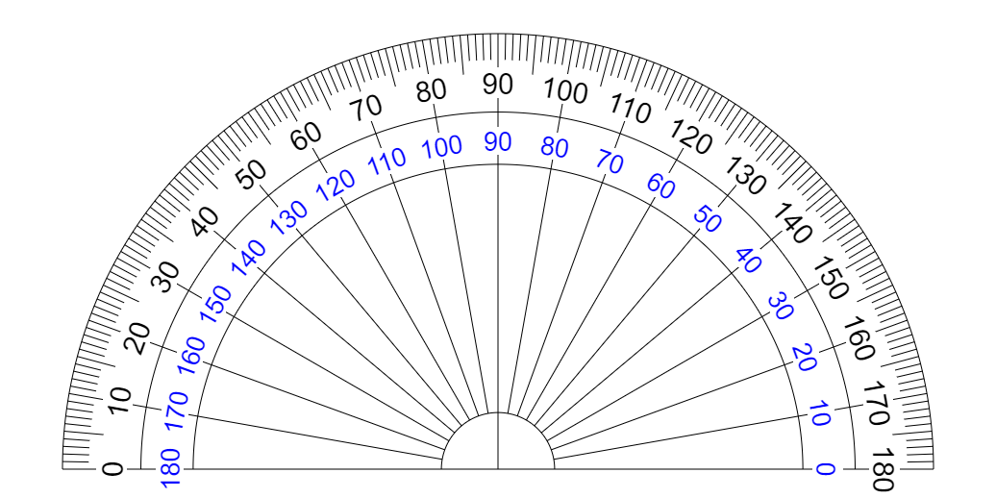
Inventario de ejercicios
STATER TRAINER

Slide 2

LANDMARKS

Slide 3
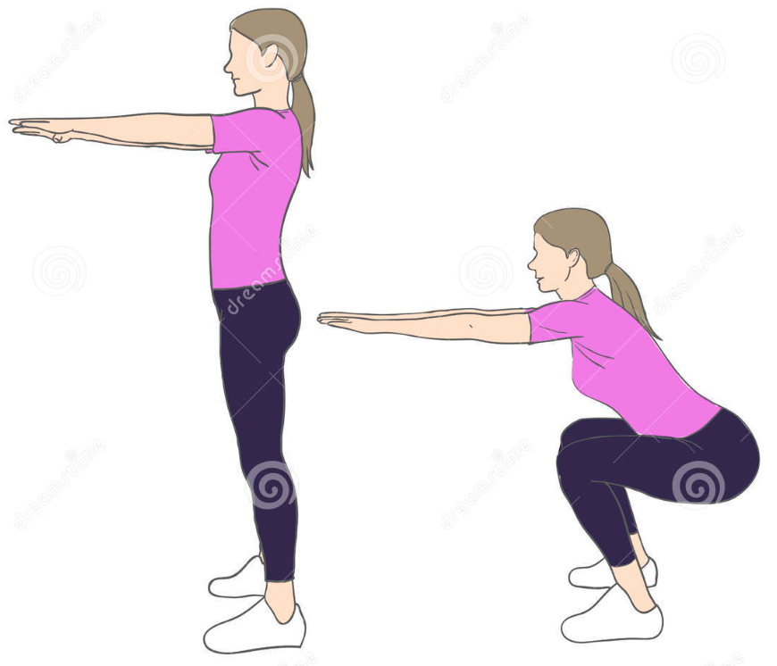
SQUATS
id exercise | name_exercise | n_poses | vista_corporal | pose | LEFT_TORSO_ANGLE Landmarks: 11. LEFT_SHOULDER 23. LEFT_HIP 25. LEFT_KNEE | RIGHT_TORSO_ANGLE Landmarks: 12. RIGHT_SHOULDER 24. RIGHT_HIP 26. RIGHT_KNEE | LEFT_ARM_ANGLE Landmarks: 11. LEFT_SHOULDER 13. LEFT_ELBOW 15. LEFT_WRIST | RIGHT_ARM_ANGLE Landmarks: 12. RIGHT_SHOULDER 14. RIGHT_ELBOW 16. RIGHT_WRIST | LEFT_LEG_ANGLE Landmarks: 23. LEFT_HIP 25. LEFT_KNEE 27. LEFT_ANKLE | RIGHT_LEG_ANGLE Landmarks: 24. RIGHT_HIP 26. RIGHT_KNEE 28. RIGHT_ANKLE | LEFT_NECK_ANGLE Landmarks: 0. NOSE 11. LEFT_SHOULDER 23. LEFT_HIP | RIGHT_NECK_ANGLE Landmarks: 0. NOSE 12. RIGHT_SHOULDER 24. RIGHT_HIP
1 | Squats | 2 | LATERAL DERECHO | 1 | None | 180° | None | 180° | None | 180° | None | None
 |  |  |  | 2 | None | 40° | None | 180° | None | 70° | None | None
 |  |  |  | 3 | None | 180° | None | 180° | None | 180° | None | None
POSE 1
POSE 3 (=POSE 1)
RIGHT_ARM_ANGLE
180°
POSE 2
RIGHT_ARM_ANGLE
180°
RIGHT_TORSO_ANGLE
180°
RIGHT_TORSO_ANGLE
40°
RIGHT_LEG_ANGLE
180°
RIGHT_LEG_ANGLE
70°

Slide 4
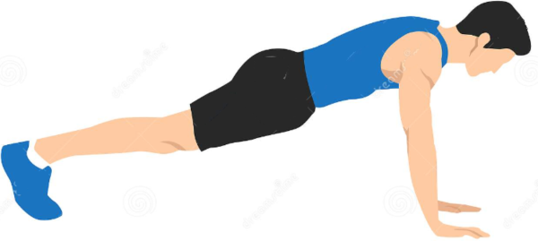
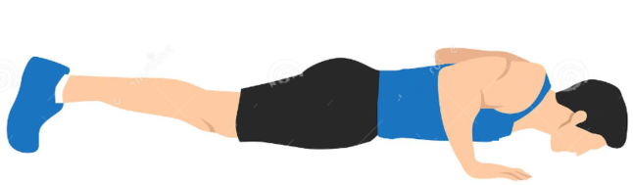
PUSH UPS
POSE 1
RIGHT_HIT_ANGLE
165°
POSE 2
RIGHT_HIT_ANGLE
175°
RIGHT_ELBOW_ANGLE
70°
RIGHT_ELBOW_ANGLE
155°
RIGHT_KNEE_ANGLE
170°
RIGHT_KNEE_ANGLE
160°
POSE 3
RIGHT_HIT_ANGLE
165°
RIGHT_ELBOW_ANGLE
155°
RIGHT_KNEE_ANGLE
170°

Slide 5
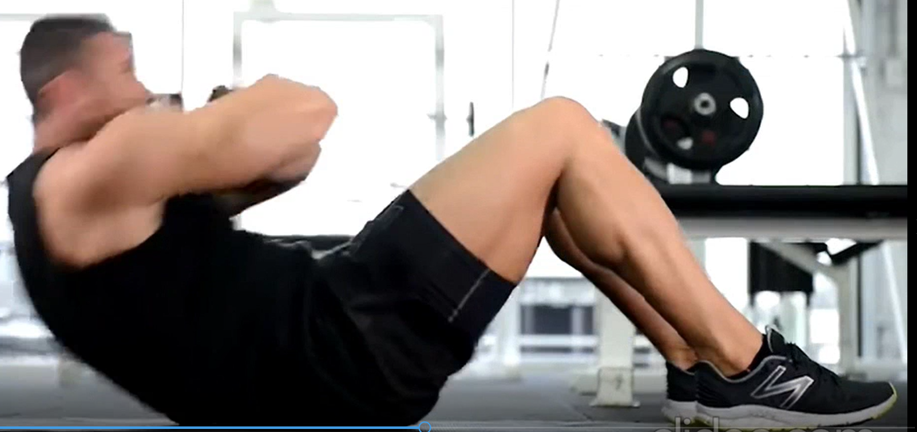
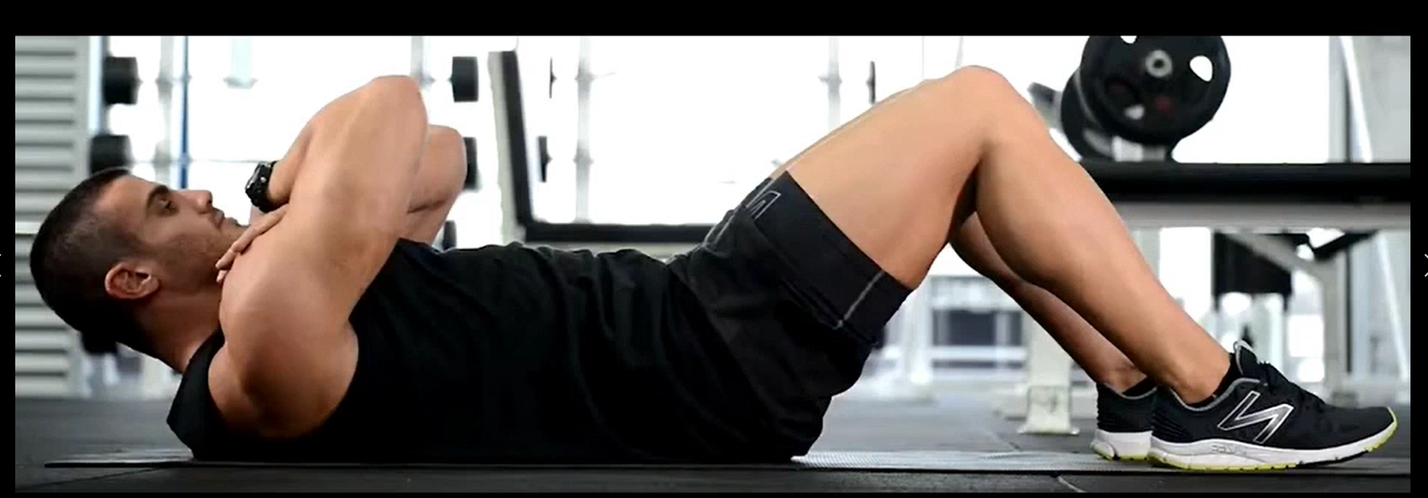
CURL UP
POSE 1
RIGHT_SHOULDER_ANGLE
40°
RIGHT_SHOULDER_ANGLE
60°
POSE 2
RIGHT_KNEE_ANGLE
80°
RIGHT_KNEE_ANGLE
65°
RIGHT_HIT_ANGLE
130°
RIGHT_HIT_ANGLE
100°
POSE 3
RIGHT_KNEE_ANGLE
80°
RIGHT_SHOULDER_ANGLE
60°
RIGHT_HIT_ANGLE
130°

Slide 6
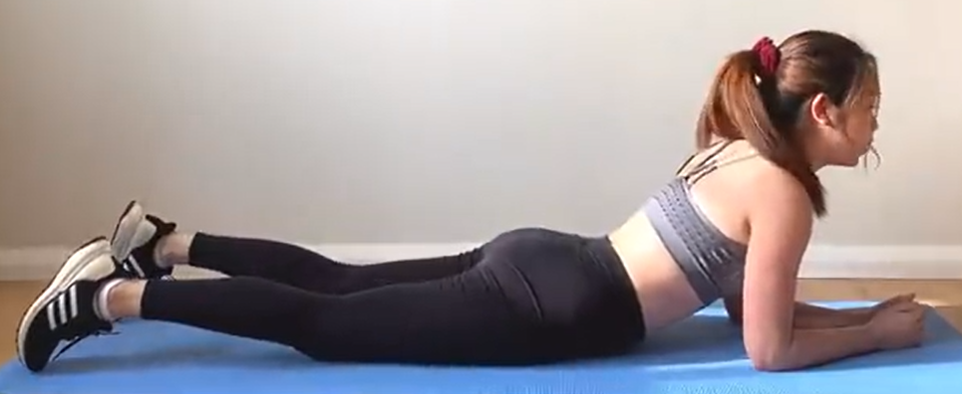
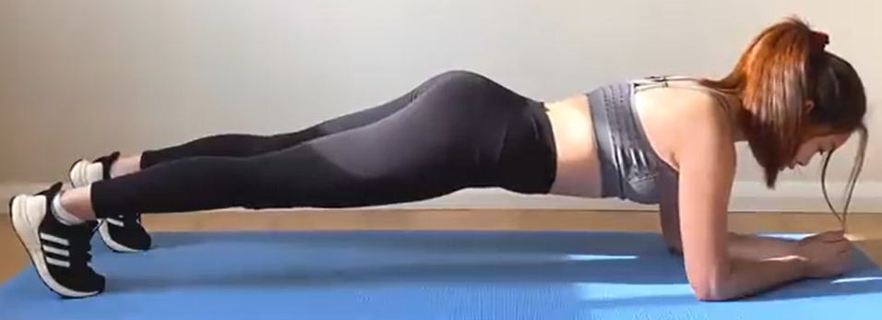
FRONT PLANK
POSE 1
POSE 2
RIGHT_HIT_ANGLE
168°
RIGHT_SHOULDER_ANGLE
60°
RIGHT_SHOULDER_ANGLE
90°
RIGHT_ANKLE_ANGLE
130°
RIGHT_HIT_ANGLE
155°
RIGHT_ ANKLE_ANGLE
80°
POSE 3
RIGHT_SHOULDER_ANGLE
60°
RIGHT_ANKLE_ANGLE
130°
RIGHT_HIT_ANGLE
155°

Slide 7
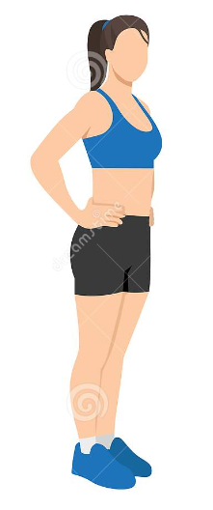
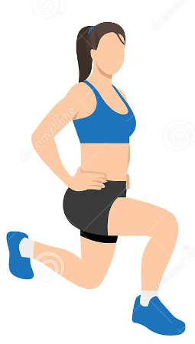
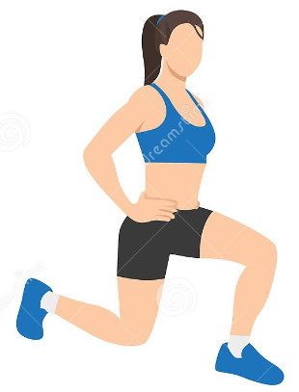
FORWARD LUNGES
POSE 1
POSE 3
POSE 5
POSE 4
POSE 2
RIGHT_HIT_ANGLE
180°
RIGHT_HIT_ANGLE
180°
RIGHT_HIT_ANGLE
180°
RIGHT_KNEE_ANGLE
180°
RIGHT_KNEE_ANGLE
90°
RIGHT_HIT_ANGLE
180°
RIGHT_HIT_ANGLE
90°
RIGHT_KNEE_ANGLE
180°
LEFT_KNEE_ANGLE
90°
RIGHT_KNEE_ANGLE
180°
LEFT_KNEE_ANGLE
90°
RIGHT_KNEE_ANGLE
90°

Slide 8
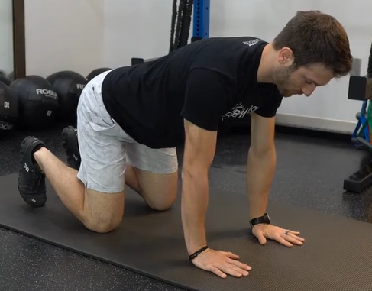
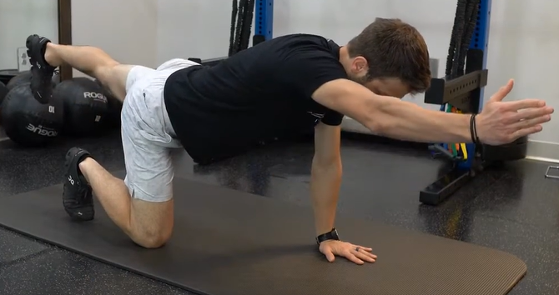
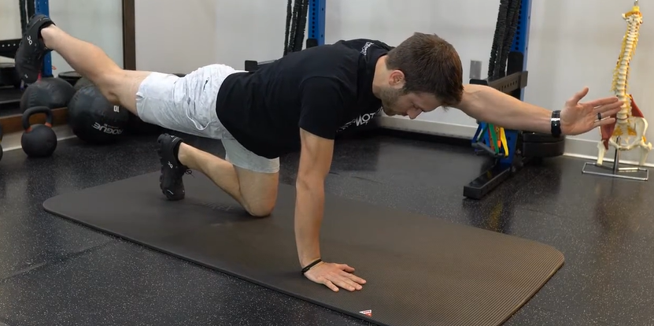
BIRD DOG
POSE 1
POSE 2
POSE 3
LEFT_KNEE_ANGLE
160°
RIGHT_HIT_ANGLE
60°
RIGHT_HIT_ANGLE
60°
RIGHT_SHOULDER_ANGLE
72°
RIGHT_SHOULDER_ANGLE
72°
RIGHT_ELBOW_ANGLE
148°
RIGHT_KNEE_ANGLE
60°
RIGHT_KNEE_ANGLE
60°
POSE 5
POSE 4
LEFT_ELBOW_ANGLE
160°
RIGHT_HIT_ANGLE
60°
RIGHT_KNEE_ANGLE
145°
RIGHT_SHOULDER_ANGLE
72°
RIGHT_KNEE_ANGLE
60°

Slide 9
FIN DE SET
FIN DE EJERCICIO

